Slide 1
Java 10 Features
JDK Enhancement Proposal

Slide 2
Agenda
JEP 286: Local Variable Type Inference
JEP 322: Time-Based Release Versioning
JEP 304: Garbage-Collector Interface
JEP 307: Parallel Full GC for G1
JEP 316: Heap Allocation on Alternative Memory Devices
JEP 296: Consolidate the JDK Forest into a Single Repository
JEP 310: Application Class-Data Sharing
JEP 314: Additional Unicode Language-Tag Extensions
JEP 319: Root Certificates
JEP 317: Experimental Java-Based JIT Compiler
JEP 312: Thread-Local Handshakes
JEP 313: Remove the Native-Header Generation Tool

Slide 3
JEP 286: Local Variable Type Inference
With Java 10, you can use var for local variables instead of a typed name (Manifest Type).
This is done by a new feature which is called Local Variable Type Inference.
What is Type Inference?
Type inference is Java compiler’s ability to look at each method invocation and corresponding declaration to determine the type argument (or arguments) that make the invocation applicable. Type Inference is not to Java programming.
For local variable declarations with initializer, we can now use a reserved type name “var” instead of a manifest type. Let’s look through a few examples.

Slide 4
Old way of declaring local variable.
String name = "Welcome";
New Way of declaring local variable.
var name = "Welcome";

Slide 5
Note points
No type inference in case of member variable, method parameters, return values.
Local variable should be initialized at time of declaration otherwise compiler will not be infer and will throw error.
Local variable inference is available inside initialization block of loop statements.
No runtime overhead. As compiler infers the type based on value provided, there is no performance loss.
No dynamic type change. Once type of local variable is inferred it cannot be changed.
Complex boilerplate code can be reduced using local variable type inference.
Map<Integer, String> mapNames = new HashMap<>();
var mapNames1 = new HashMap<Integer, String>();

Slide 6
JEP 322: Time-Based Release Versioning
Releases are further categorized into three broad categories.
Feature Release − A Feature Release contains language specific features, JVM features, New/Improved APIs, Removal/Deprecation of APIs. Time of these feature releases is fixed and there is no constraint on features to be included in a particular release. If a under development feature is not a part of latest release then it will be planned in next release.
Update Release − An Update Release includes bug fixes, security issue fix, regression fixes etc. Each update release is planned per quarter in Jan, April, July and Oct months. Each Feature release will receive two Update releases before next feature release is announced.
Long Term Support(LTS) Release − Long term support release will be announced after every three years starting from Sep, 2018. Oracle will provide support and updates for this release for next three years. This release is primarily for Corporates using Java in production deployments.

Slide 7
Version Format
$FEATURE.$INTERIM.$UPDATE.$PATCH
$FEATURE: This counter will be incremented at every feature release regardless of release content. The feature counter for the current release is 10.
$INTERIM: This counter will be incremented for non-feature releases that contain compatible bug fixes and enhancements but no incompatible changes, no feature removals, and no changes to standard APIs.
Since the six-month model does not include interim releases, this will always be zero. It is reserved for flexibility, so that a future revision may include something like JDK $N.1 and JDK $N.2 etc. For example, JDK 1.4.1 and 1.4.2 releases were interim releases, and according to the new versioning system, they would have been numbered 4.1 and 4.2.
$UPDATE: The update-release counter, incremented for compatible update releases.
The April 2018 release will be JDK 10.0.1 with the update counter 1, the July release will be JDK 10.0.2 with the update counter 2, and so forth.
$PATCH: The emergency patch-release counter, incremented only when it's necessary to produce an emergency release to fix a critical issue.

Slide 8
JEP 304: Garbage-Collector Interface
Java 10 includes a new cleaner Garbage-Collector to improve the source code isolation of different garbage collectors.
Java introduced a clean garbage collector interface that helps to implement new collectors and makes code much cleaner, simpler.
In older versions of JDK, Garbage Collector (GC) components were scattered throughout various parts of the codebase.
But in Java 10, it is a clean interface within the JVM source code to allow alternative collectors to be quickly and easily integrated.
Before Java 10, GC (Garbage Collector) implementation components were scattered within code base and were not replaceable easily. With Java 10, Garbage-Collector interface is introduced so that alternative GC implementations can be plugged in.
It also helps in isolating the code base from different garbage collection implementations.

Slide 9
Types of Garbage Collector
There are four types of the garbage collector in Java that can be used according to the requirement:
Serial Garbage Collector
Parallel Garbage Collector
Concurrent Mark Sweep (CMS) Garbage Collector
Garbage First (G1) Garbage Collector

Slide 10
JEP 307: Parallel Full GC for G1
Java 9 introduced G1 (Garbage First) garbage collector.
G1 avoids full garbage collection but in case of concurrent threads look for collection and memory is not revived fast enough, user experience is impacted.
With Java 10, now G1 will use a fall back Full Garbage Collection.
With this change, G1 improves its worst-case latency by using a Full GC in parallel.
At present, G1 uses a single threaded mark-sweep-compact algorithm. With JEP 307, a parallel thread will start mark-sweep-compact algorithm. Number of threads can be controlled using following option.
$java -XX:ParallelGCThreads=4
You can also customise how many threads are used with the option -XX:ParallelGCThreads, though keep in mind that this will also affect the number of threads used for the Young and Mixed / minor collections too.

Slide 11
JEP 316: Heap Allocation on Alternative Memory Devices
The goal of this change is to enable the HotSpot VM to allocate the Java object heap on an alternative memory device, such as an NV-DIMM, specified by the user.
To allocate the heap in such memory we can add a new option, -XX:AllocateHeapAt=<path>.
This option would take a path to the file system and use memory mapping to achieve the desired result of allocating the object heap on the memory device.
The existing heap related flags such as -Xmx, -Xms, etc., and garbage-collection related flags would continue to work as before.

Slide 12
JEP 296: Consolidate the JDK Forest into a Single Repository
Up to Java 9, JDK's code base used multiple repositories (there are eight repositories in Java 9—root, corba, hotspot, jaxp, jaxws, jdk, langtools, and nashorn). Consolidating the JDK forest aims to combine the multiple repositories used by the JDK into a single repository.
As JDK's code base grew over the years, it was stored in separate repositories on purpose, for a separation of concerns. However, as the JDK evolved, the code base also developed interdependencies across different repositories.
The advantages offered by these multiple repositories have outgrown the disadvantages with their maintenance.
As part of this change numerous repositories of the JDK forest is combined into a single repository in order to simplify and streamline development.

Slide 13
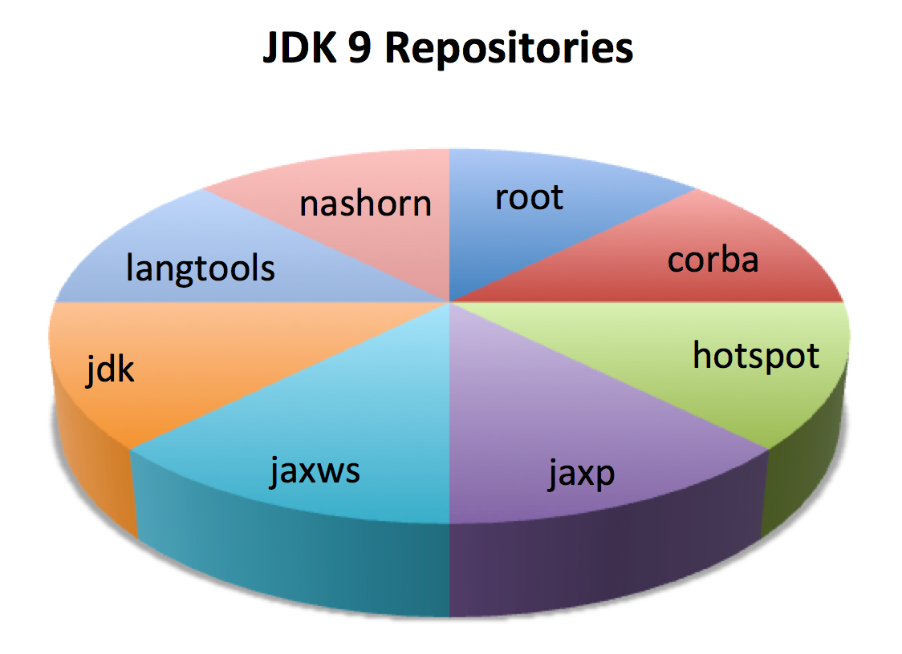

Slide 14
For example, today in the JDK forest there are module-based directories like
$ROOT/jdk/src/java.base
...
$ROOT/langtools/src/java.compiler
...
In the consolidated forest, this code is instead organized as-
$ROOT/src/java.base
$ROOT/src/java.compiler
...

Slide 15
JEP 310: Application Class-Data Sharing
class data sharing features that can help reduce the startup time and memory footprints for Java applications.
The class data sharing (CDS) feature helps reduce the startup time and memory footprints between multiple Java Virtual Machines (JVM) which was a big foot forward here.
When you use the installer to install the Oracle Java Runtime Environment (JRE), the installer loads a default set of classes from the system Java Archive (JAR) file into a private internal representation and dumps that representation to a file called a shared archive.
If the JRE installer is not being used, then you can generate the shared archive manually.
When the JVM starts, the shared archive is memory-mapped to allow sharing of read-only JVM metadata for these classes among multiple JVM processes.
Because accessing the shared archive is faster than loading the classes, startup time is reduced.

Slide 16
Class data is supported with the G1, serial, parallel, and parallelOldGC garbage collectors.
The shared string feature (part of class data sharing) supports only the G1 garbage collector on 64- bit non-Windows platforms.
The primary motivation for including CDS in Java SE is to decrease in startup time.
The smaller the application relative to the number of core classes it uses, the larger the saved fraction of startup time.

Slide 17
The footprint cost of new JVM instances has been reduced in two ways:
A portion of the shared archive on the same host is mapped as read-only and shared among multiple JVM processes. Otherwise, this data would need to be replicated in each JVM instance, which would increase the startup time of your application.
The shared archive contains class data in the form that the Java Hotspot VM uses it. The memory that would otherwise be required to access the original class information in the runtime modular image, is not used. These memory savings allow more applications to be run concurrently on the same system. In Windows applications, the memory footprint of a process, as measured by various tools, might appear to increase, because more pages are mapped to the process’s address space. This increase is offset by the reduced amount of memory (inside Windows) that is needed to hold portions on the runtime modular image. Reducing footprint remains a high priority.

Slide 18
JEP 314: Additional Unicode Language-Tag Extensions
Java 7 introduced support for ( Best Current Practices )BCP 47 Language tags. But this unicode locale extensions was limited to calendar and numbers. With Java 10, java.util.Locale and related classes are updated to implement additional unicode extensions as specified in LDML(
Locale Data Markup Language) specification
It’s goal is to enhance java.util.Locale and related APIs to implement additional Unicode extensions of BCP 47 language tags. Support for BCP 47 language tags was was initially added in Java SE 7, with support for the Unicode locale extension limited to calendars and numbers.
This JEP will implement more of the extensions specified in the latest LDML specification, in the relevant JDK classes.
This JEP will add support for the following additional extensions:
cu (currency type)
fw (first day of week)
rg (region override)
tz (time zone)

Slide 19
Related APIs which got modified are:
java.text.DateFormat::get*Instance
java.text.DateFormatSymbols::getInstance
java.text.DecimalFormatSymbols::getInstance
java.text.NumberFormat::get*Instance
java.time.format.DateTimeFormatter::localizedBy
java.time.format.DateTimeFormatterBuilder::getLocalizedDateTimePattern
java.time.format.DecimalStyle::of
java.time.temporal.WeekFields::of
java.util.Calendar::{getFirstDayOfWeek,getMinimalDaysInWeek}
java.util.Currency::getInstance
java.util.Locale::getDisplayName
java.util.spi.LocaleNameProvider

Slide 20
JEP 319: Root Certificates
In order to promote OpenJDK and make it more appealing to community users, this feature provides a default set of root Certification Authority (CA) certificates in the JDK.
This will also mean that both Oracle & Open JDK binaries will be functionally the same.
Critical security components such as TLS will work by default in OpenJDK builds going forward.

Slide 21
Cacerts store, prior to Java 10 is an empty set.
It is required to contain a set of certificates which can be used to establish trust in certificates chain of various security protocols of vendors.
OpenJDK builds are not having such certificates which is why critical security components like TLS
Transport Level Security (TLS)
didn't work in default build.
Now as Oracle has open sourced the root certificates using Oracle JAVA SE Root CA program, OpenJDK builds can now have root certificates and thus can reduce the difference between OpenJDK and Oracle JDK.
Oracle JAVA SE Root CA program issues the root certificates. Vendors who've signed the agreement, are included in the set of root certificates. The vendors who are not registered will be included in next release.

Slide 22
JEP 317: Experimental Java-Based JIT Compiler
JIT compiler is written in C++ and is used to convert Java into Byte Code.
Now Java 10 has option to enable an experimental Java based JIT compiler, Graal to be used instead of standard JIT compiler.
Graal is using JVMCI, JVM Compiler Interface which was introduced in Java 9. Graal is available in Java 9 as well.
With Java 10, we can enable Graal to test and debug the experimental JVM compiler.

Slide 23
Syntax
java -XX:+UnlockExperimentalVMOptions -XX:+UseJVMCICompiler
Graal compiler is a complete rewrite of C++ based earlier compiler and is targeted for Linux/x64 based platform.
Graal was introduced in Java 9 as an alternative of JIT compiler presently in use.
Graal is a plugin to JVM and can be dynamically plugged in. It supports polyglot language interpretation as well.

Slide 24
JEP 312: Thread-Local Handshakes
In JDK 10, a new option is introduced for JVM as -XX:ThreadLocalHandshakes. This options works only for x64 and SPARC based machines.
This option is available to improve VM performance. It allows to make a callback on application threads without making a global VM safepoint.
Thus allows JVM to stop an individual thread without stopping all threads.
As this options is not available to all platforms, other platforms will fall back to normal safepoints.
What is safepoint?
A point during program execution at which all GC roots are known and all heap object contents are consistent. All threads must block at a safepoint before the GC can run.

Slide 25
How Java 10 will improve performance
Instead of waiting for a global safe point to stop all the threads we use a callback to affect individual threads.
The callback will trigger when a thread is in a safe point and allow it to be stopped as soon as possible.
It can then be started again as soon as the JVM has finished any tasks it was performing to the thread.
In short, threads are no longer all or nothing when it comes to stopping them. We can instead stop threads individually allowing others to continue, cutting down on the number of stops to all threads.

Slide 26
JEP 313: Remove the Native-Header Generation Tool
You can find java, javac and javadoc but there is no javah.exe in jdk\\bin folder after Java 9.
The tool javah.exe was removed in Java 10. The reason is simple, it is obsolete. From JEP 313: Remove the Native-header Generation Tool (javah).
The tool has been superseded by superior functionality in javac, added in JDK 8 (JDK-7150368). This functionality provides the ability to write native header files at the time that Java source code is compiled, thereby eliminating the need for a separate tool.
Focusing on the support provided by javac eliminates the need to upgrade javah to support recent new paradigms, such as API access via the Compiler API in javax.tools.*, or the new java.util.spi.ToolProvider SPI added in JDK 9.

